Slide 1
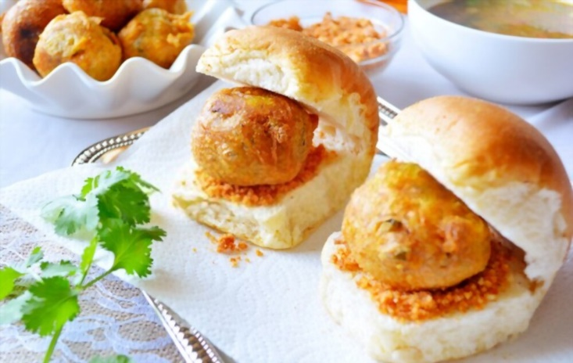
WelCome
Analytical Solution – Wada-Pav Stall

Slide 2
Agenda :
Introduction
Problem Statement
Problem Analysis
Solution
Impact

Slide 3
Introduction
A man wanted to open a Wada-Pav shop at shivajinagar with having no prior idea about the place and how he have to start.
He have only idea about there is already four restaurants are there who are doing same business.
We have to find out a solution for this problem.

Slide 4
Problem Statement
A man wants to open a Wada-Pav Shop near Shivaji Nagar in Pune. He has got a location where there are other 4 more Wada-Pav shops. He is not able to understand what will be the strategy to take over his clients.
a. What will be the price of each Wada-Pav?
b. How will he differentiate from the other competitors?
c. How will you bring insights when he has no data of his shop?
d. Why will be the Customer comes to your shop? (What will be the positioning)
e. What Machine Learning Models you will used to take to solve this Problem Statement? Whether Data Science is really required or not?

Slide 5
Problem Analysis
As given in the problem statement he don’t have prior data to start a Wada-Pav Shop at Shivaji Nagar Pune.
But We have Four restaurant that we can analyse.
So go for it, First we have to analyse that four restaurant data, which type of problem the owners are facing already.
Why customer are not buying the Wada-Pav from that four restaurant, we have to analyse this.
We have to analyse the most affecting factors which are ultimately affecting the Sales of Wada-Pav.
Suppose below mentioned table is data collected from restaurants which showing problems and number of customer not purchasing due to that particular problem (Data is just Intuition).

Slide 6
Data of Four Restaurant
Problems | Avg of Loss of Customer for 4 Resto | Cum Freq | Cum Freq %
Taste of Food | 120 | 120 | 31.66%
Quality of Food | 102 | 222 | 58.58%
Hygiene | 80 | 302 | 79.68%
Quantity of Food | 30 | 332 | 87.60%
Insufficient Space | 27 | 359 | 94.72%
Price | 20 | 379 | 100.00%
With the help of above data we can find out the graphical representation through which we can decide which factors are affecting more for sales of Wada-Pav.
With the help below graph we can find out the most affecting factors in Sales of Wada-Pav.
This graph is also known as Pareto chart or 80 20 Principle graph, with the help of this we can find out more affecting problems in sour sales of Wada-Pav.

Slide 7
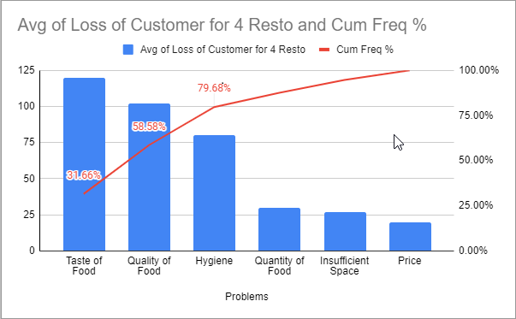
Pareto Chart for Data of Four Restaurant

Slide 8
Solution :
By looking at the above graph we can say that most of the factors which are affecting in sales of Wada-Pav are 1) Taste of Food 2) Quality of Food 3) Price of Food.
So the solution for this given problem is that he have to give very good test as well as quality in affordable price then and only then He can do better business.

Slide 9
Impact :
He can attracts 79.68% of customer at his shop.
He can do near 80% better business than other.

Slide 10
Thank You
Presented By
Mr. Nikhil Darokar
(A Fututre Data Scientist)

